Slide 1
Growing a Tribe
A Workshop

Slide 3
Yuri in 2007

Slide 4
What is a Tribe?

Slide 6
“One Christian is no Christian”

Slide 7
To whom do you belong?

Slide 8
Does your ‘Tribe’ belong to you?

Slide 9
Should CYMK grow?
Should the Church grow?

Slide 10
Tools for Growth
How do you start a conversation?
How do you ask questions?
How should body language play a role?
What shouldn’t you do?
How should your cell phone be used?

Slide 11
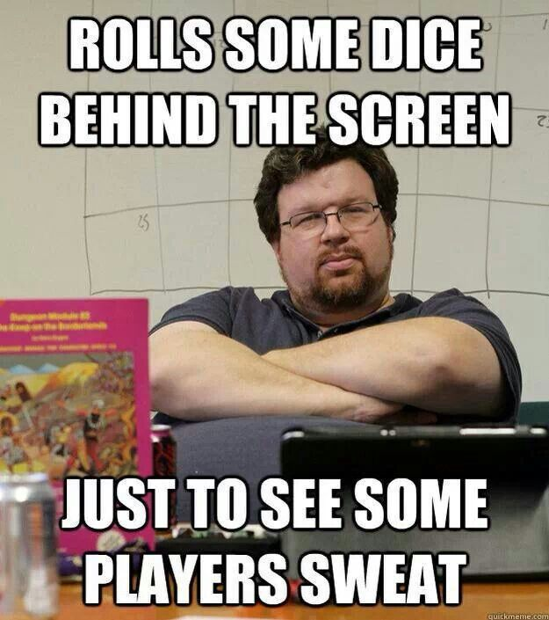
Role-Playing-Games

Slide 12
Scenario #1
You’re in a van on a trip with your local CYMK friends and there is someone new joining you that day. How do you start and maintain a conversation?

Slide 13
Scenario Two
There is a person younger than you that attends Church only a couple of times a year. You know them by face but have never spoken to them. You happen to see them at this year’s Great and Holy Friday Vespers. How should you approach meeting them for the first time?

Slide 14
Scenario iii
An older youth you have never seen for the first time has come to your church. During fellowship (coffee hour) you are sitting at your usual table with family and friends and you notice this new person sitting at another table. What are some strategies you can use to engage them?

Slide 15
I need some brave volunteers

Slide 16
Fourth Scenario
You have moved to a new city and are attending church for the first time. How do you engage this churches youth as a visitor?

Slide 17
Scenario: The Fifth
You are at the mall and you see a young person from your church that you usually don’t talk to. How do you start a conversation with them?

Slide 18
1 Corinthians 12: 4-26
4 There are diversities of gifts, but the same Spirit. 5 There are differences of ministries, but the same Lord. 6 And there are diversities of activities, but it is the same God who works all in all. 7 But the manifestation of the Spirit is given to each one for the profit of all: 8 for to one is given the word of wisdom through the Spirit, to another the word of knowledge through the same Spirit, 9 to another faith by the same Spirit, to another gifts of healings by the same Spirit, 10 to another the working of miracles, to another prophecy, to another discerning of spirits, to another different kinds of tongues, to another the interpretation of tongues. 11 But one and the same Spirit works all these things, distributing to each one individually as He wills.
12 For as the body is one and has many members, but all the members of that one body, being many, are one body, so also is Christ. 13 For by one Spirit we were all baptized into one body—whether Jews or Greeks, whether slaves or free—and have all been made to drink into one Spirit. 14 For in fact the body is not one member but many.
15 If the foot should say, “Because I am not a hand, I am not of the body,” is it therefore not of the body? 16 And if the ear should say, “Because I am not an eye, I am not of the body,” is it therefore not of the body? 17 If the whole body were an eye, where would be the hearing? If the whole were hearing, where would be the smelling? 18 But now God has set the members, each one of them, in the body just as He pleased. 19 And if they were all one member, where would the body be?

Slide 19
20 But now indeed there are many members, yet one body. 21 And the eye cannot say to the hand, “I have no need of you”; nor again the head to the feet, “I have no need of you.” 22 No, much rather, those members of the body which seem to be weaker are necessary. 23 And those members of the body which we think to be less honorable, on these we bestow greater honor; and our unpresentable parts have greater modesty, 24 but our presentable parts have no need. But God composed the body, having given greater honor to that part which lacks it, 25 that there should be no schism in the body, but that the members should have the same care for one another. 26 And if one member suffers, all the members suffer with it; or if one member is honored, all the members rejoice with it.

